Slide 1
ERTMS Solutions ERTMSFormalSpecs (EFS) A domain specific language to formalize ERTMS specifications for onboard unit development
Stanislas Pinte
Laurent Ferier
Svitlana Lukicheva

Slide 2
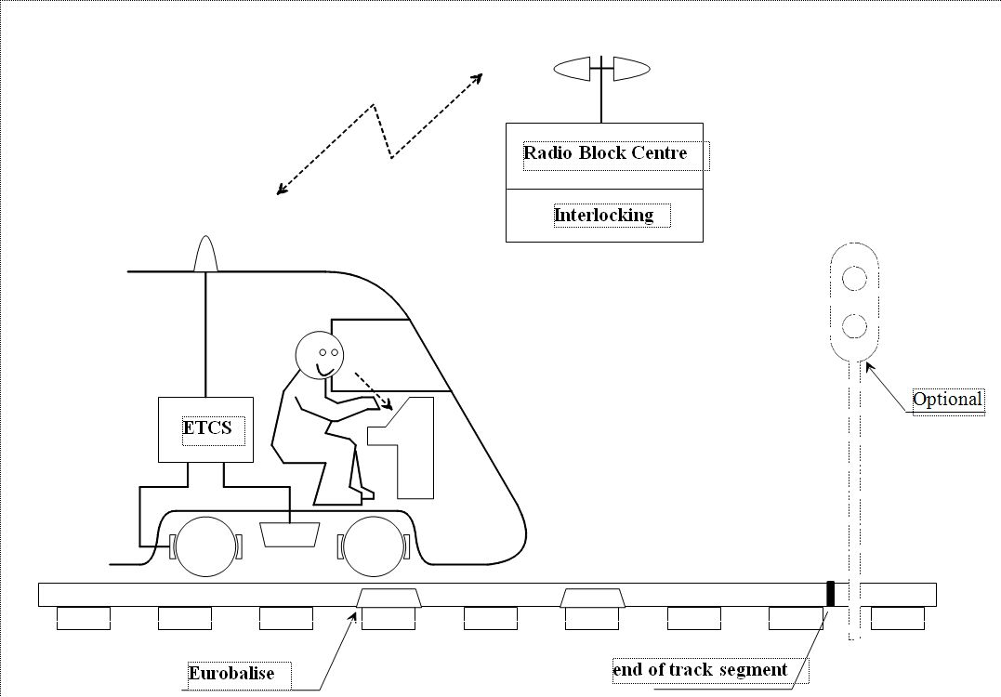
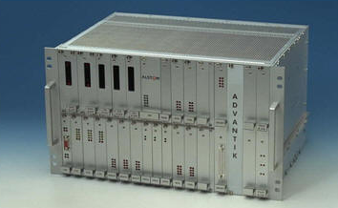
The Context
ERTMS business logic
Fully defined by Subset-026
Safety software architecture
Supplier dependant
Hardware
Supplier dependant

Slide 3

The Challenge
Subset-026
Specification of the EVC behaviour
Normative document
Issues
Natural language
Structure
Size
Completeness
Consistency
Releases

Slide 4

Impact for the supplier and user
Interpretation issues
Interoperability
Safety
Costs
Development costs
Maintenance costs

Slide 5





ERTMSFormalSpecs
ERTMS Specifications
100% ERTMS Business Logic
Formal Language
CASE tool
Ada
B
C
SIL4
Interpreter
Test tools
Target

Slide 6

Encompasses the complete process
Requirements / Model / Testing
Traceability
Model & functional tests
Subset-026
New requirements: gaps in Subset-026
Metrics
Review
History

Slide 7

Understandability
Model as close as possible to Subset-026
Formal language should match Subset-026 expressivity
High level artifacts
State machines
Interaction diagrams
Braking curves

Slide 8

Testing
100% model in the loop testing
Functional tests, related to Subset-026 requirements
Integration tests as expressed in Subset-076
Niceties
Model animation
Test traces
Step by step folding / unfolding

Slide 9

Interpretation model
EFS Model
Input
Internal
Output
Input
Output
Validation +
Business
Business
Input
Output
Input
Output
Cleanup
Cleanup
Cleanup

Slide 10

Interpretation model
Interpretation machine
Based on variables (representing EVC state, input messages, …)
Rule machine: for each rule
Evaluate rule’s preconditions based on the variable’s state…
… and if they are satisfied, apply rule’s body to change the interpretation machine’s internal variables
One interpretation model:
High level structures (state diagrams, tables) are translated into rules, and interpreted as such

Slide 11

ERTMSFormalSpecs live presentation
The basics

Slide 12
EFS DSL coverage
Chapter 1
Typical data structures, used to describe
internal data used to model concepts of chapter 2 and 3
packets of chapter 7, messages from chapter 8
functions, also used to model tables
State machines, used to describe
mode transitions from chapter 4
procedures of chapter 5
Rule based interpretation machine
to model system behaviour (all chapters)
Braking curves
Huge amount of chapter 3
Chapter 2
Chapter 3
Ch.3
Brake
Chapter 4
Chapter 5
Chapter 6
Chapter 7
Chapter 8

Slide 13
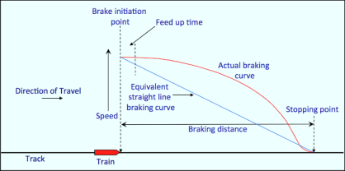
Braking curves

Slide 14
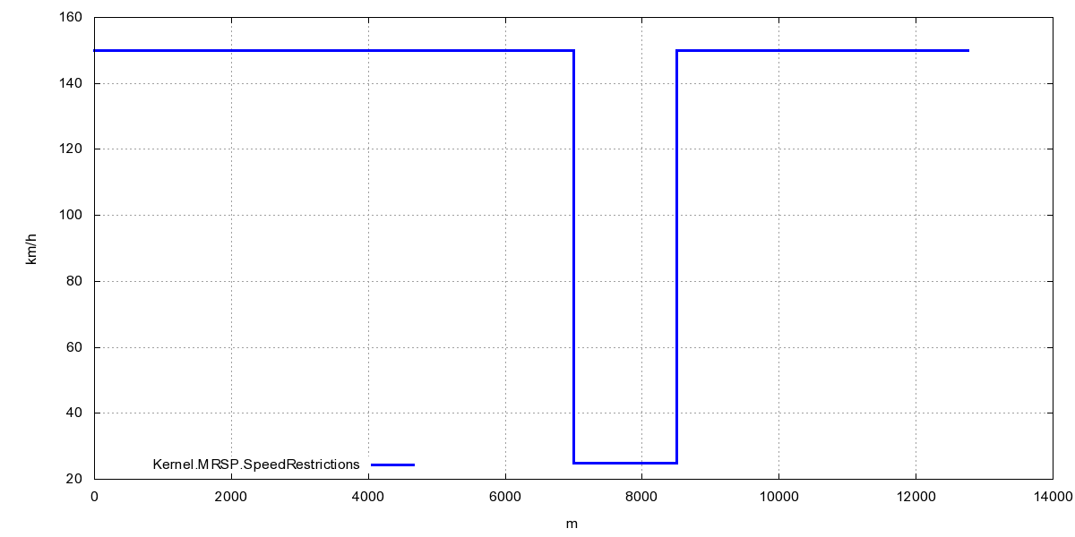
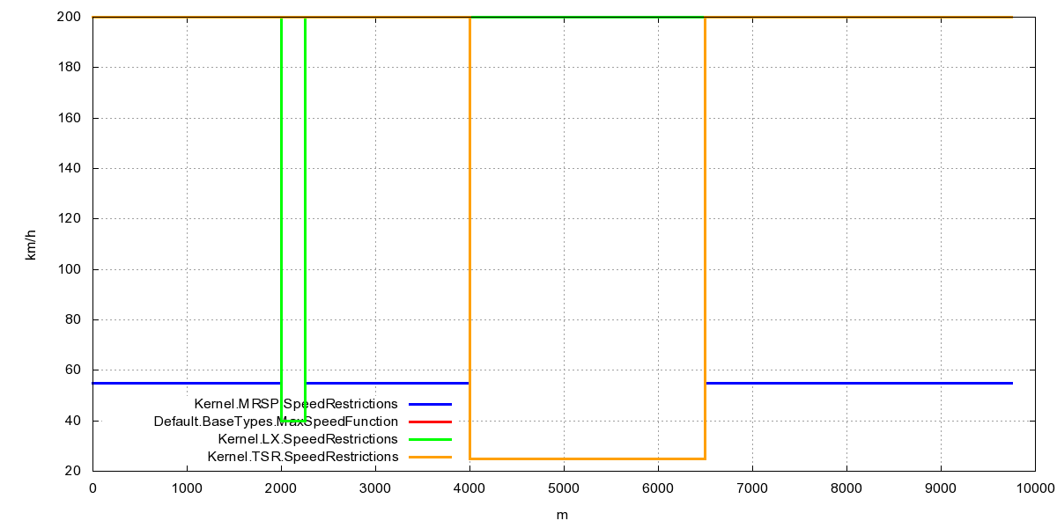
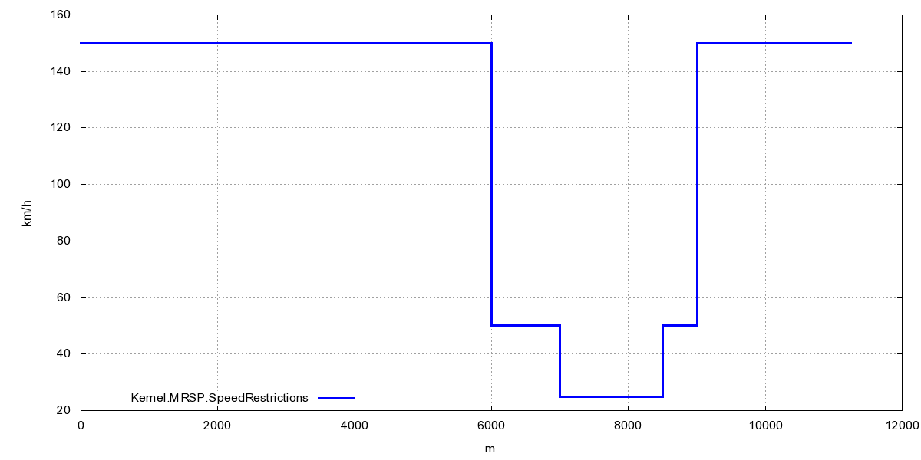
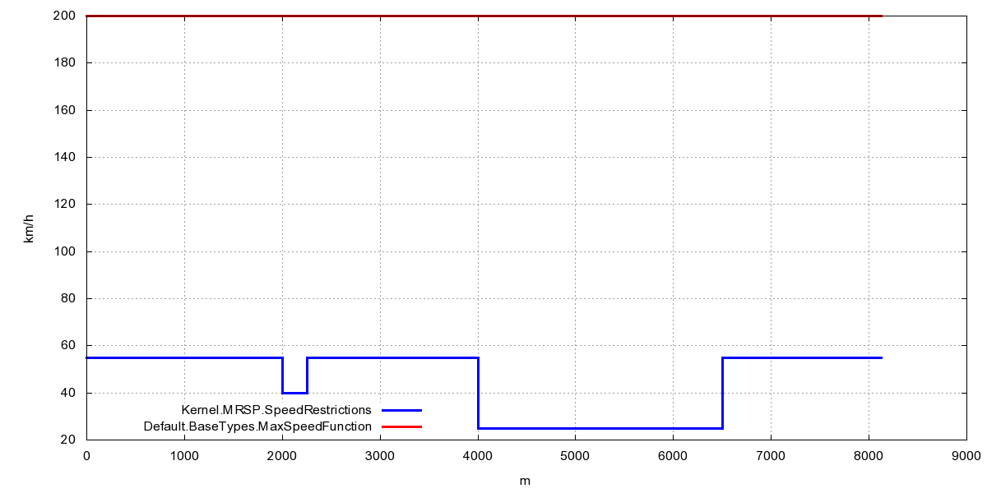
Braking curves modeling
Model by functional composition
Speed restriction example: TSRs
Single TSR
Several TSRs
Handle other speed restrictions
Provides a complex speed profile
Explanation is available
FUNCTION TSRSpeedRestriction(
aTSR : TemporarySpeedRestriction
Distance : Default.BaseTypes.Distance
) RETURNS Default.BaseTypes.Speed
// During TSR
aTSR.Location <= Distance AND
Distance < aTSR.Location + TSRLength (aTSR)
=> aTSR.Speed
// Outside TSR
=> BaseTypes.Speed.MaxSpeed
FUNCTION SpeedRestrictions(
Distance : Default.BaseTypes.Distance
) RETURNS Default.BaseTypes.Speed
// Value
=>
(REDUCE TSRs USING
MIN(
First => TSRSpeedRestriction(X, d),
Second => RESULT)
INITIAL_VALUE MaxSpeedFunction
)(Distance)

Slide 15
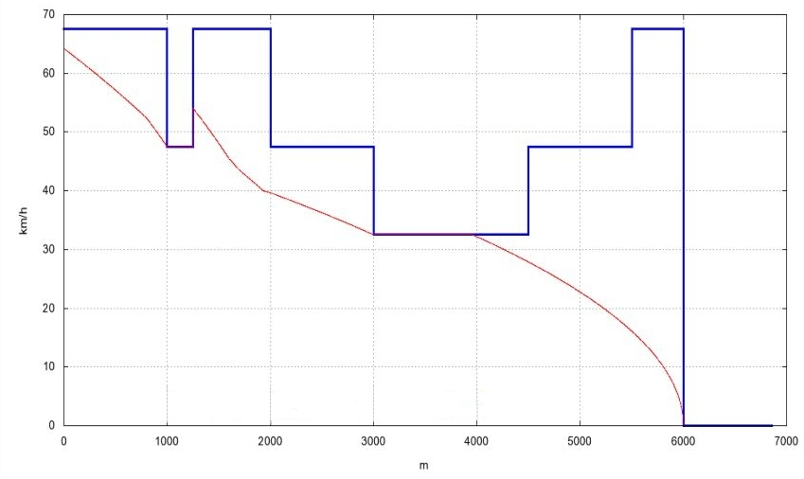
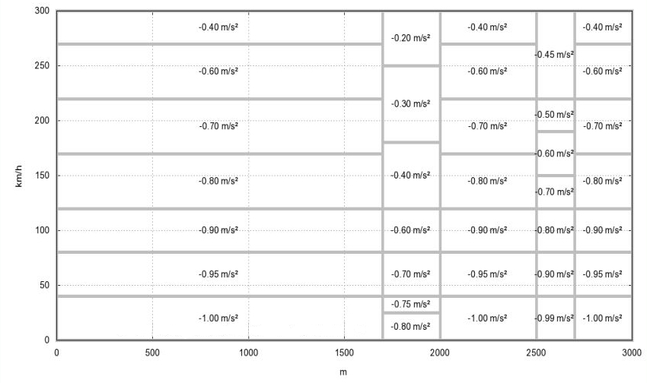
Deceleration factors
The same technique is applied to compute deceleration factors
Computation of the deceleration curves
based on P (variant SBI, EBI)
and the deceleration factor

Slide 16


Braking curves

Slide 17
Braking curves comparative results
Comparison with ERA braking curve spreadsheet
Tool differences
ERA spreadsheet handle a single target
whereas EFS handles complex speed profiles
Results
Same results for the simplest cases (modulo ɛ)
Similar results for complex deceleration factors
due to discrete computation in the spreadsheet
acceptable : initial train speed=140km/h induced Δ=20cm
note : acceptable error not defined in Subset26

Slide 18
ERTMSFormalSpecs live presentation
Braking curves

Slide 19

Subset 076 - Scope
Subset 076
Define interoperability tests between trackside & trainborne
Inputs from either trackside or driver
Expected output from EVC
Define EVC integration tests
Available as word documents, generated from an Access database
The idea is to apply Subset-076 tests to EFS model.

Slide 20

Subset-076 and EFS
Integration model
Source is the (non formal) subset 076 Access database
Imported as structured text in the EFS test database
Access databases are no more useful
Automate the translation process
Some parts might not be automated
Text
Textual
tranlations
S76 Access
databases
EFS tests
database
Textual import
Model

Slide 21

Translations
Subset-076 steps are expressed as plain English
Need to formalize this as
Actions : changes in the system
Expectations : expected system state
Translation dictionary
Associate one (or more) English phrase with sequences of actions / expectations
The same translations rules can be applied to several Subset-076 test cases

Slide 22
ERTMSFormalSpecs live presentation
Subset-076 integration

Slide 23

Current status
Modeling status
Subset-026: 3225 applicable requirements
Modeled: 1061
Completion: about 33 %
Testing
Unit tests: 15% tested
Subset-076:
Database imporation tool complete
Manual translation ongoing

Slide 24
Your comments (questions, remarks, jokes) …
… are welcome!

